Slide 1
Java Mini Project
Devansh Sahu (2021200104)
Mihir Rumao (2021200103)
Akaash Sharma (2021200108)

Slide 2
Problem Statement
Develop a snake game for 2 players.
The Snake class: Length and location of snake
The Score class: Inherits Apple and displays score according to length
The BoundingBox class : Describes the play space of the game and inherits Snake class
The BoundingBox will define the max dimensions of the play space
generateApple() will generate an apple at random coordinates within the max dimensions

Slide 3
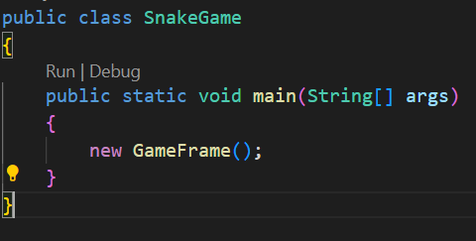
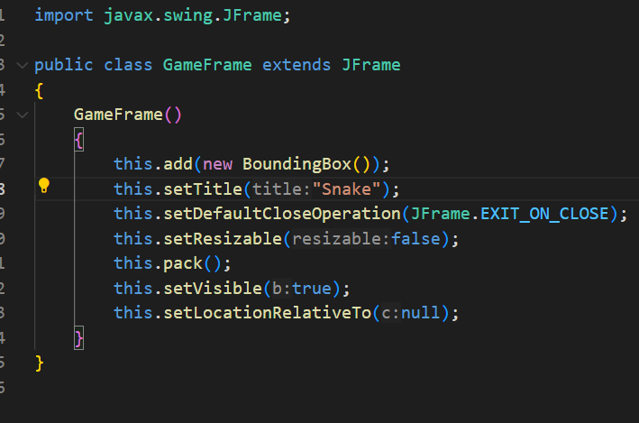
PROGRAM

Slide 4
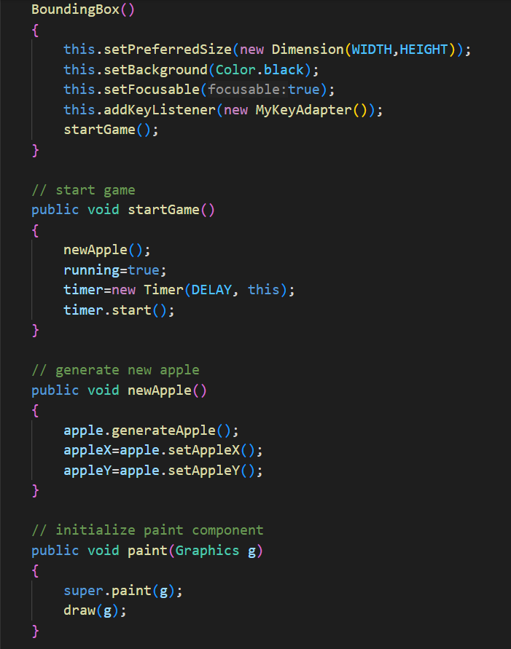
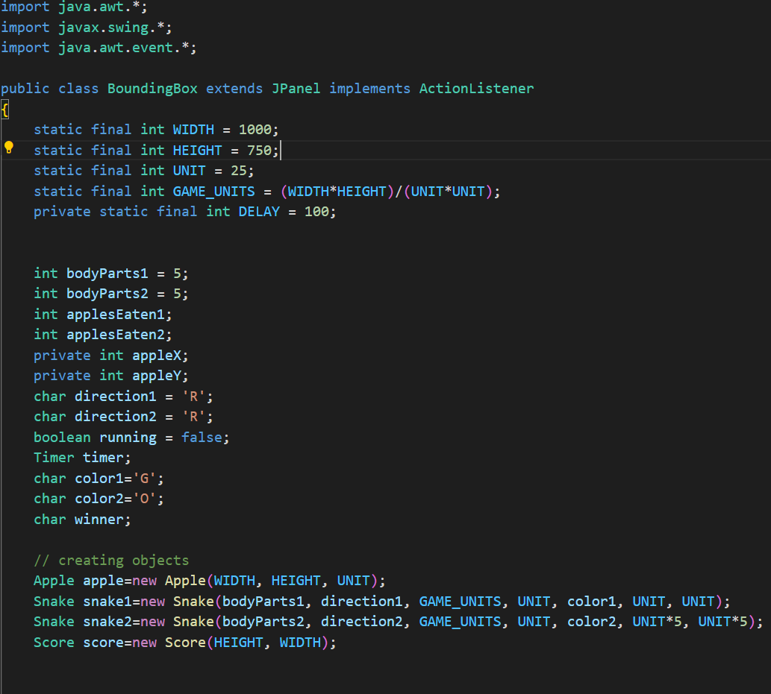
Bounding Box

Slide 5
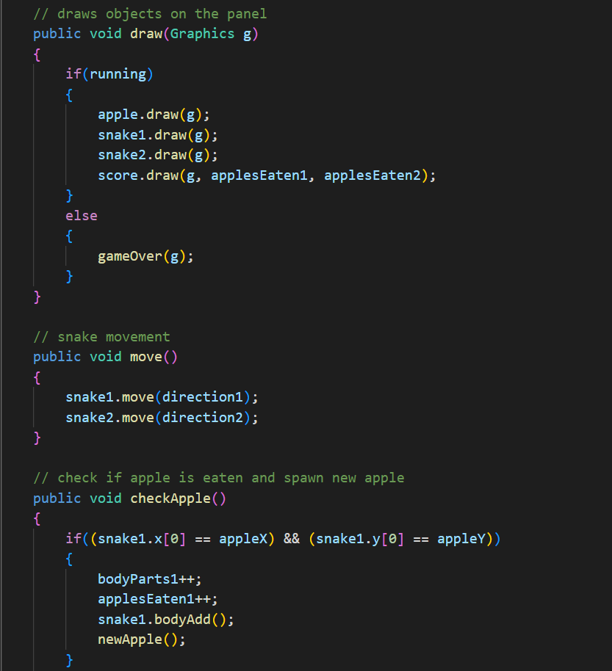
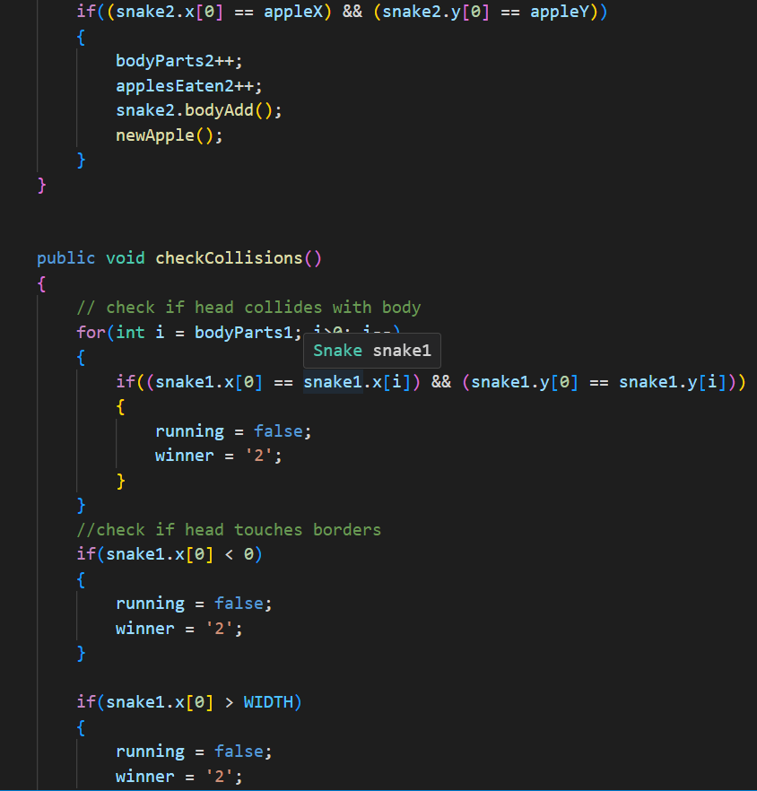

Slide 6
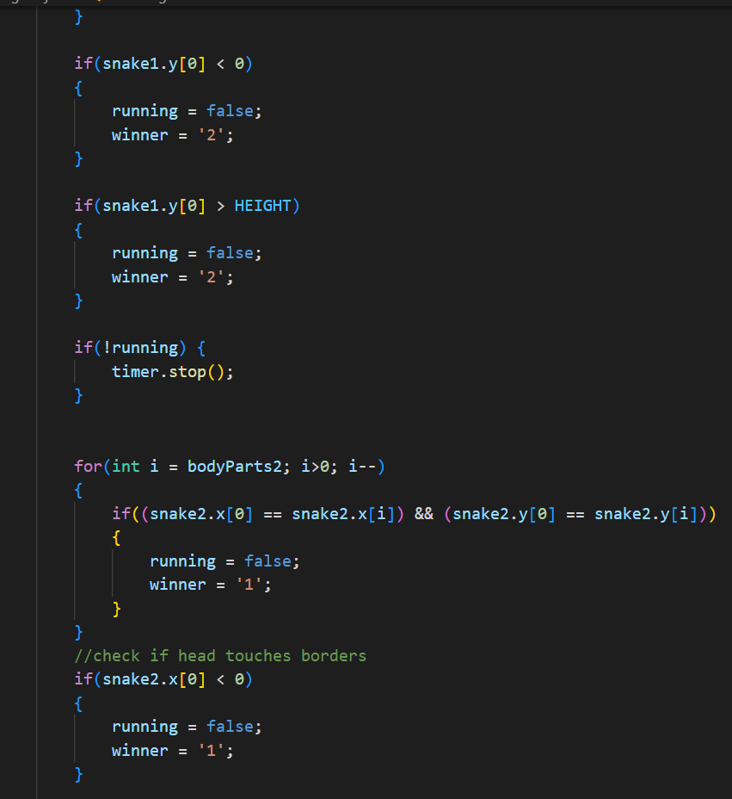
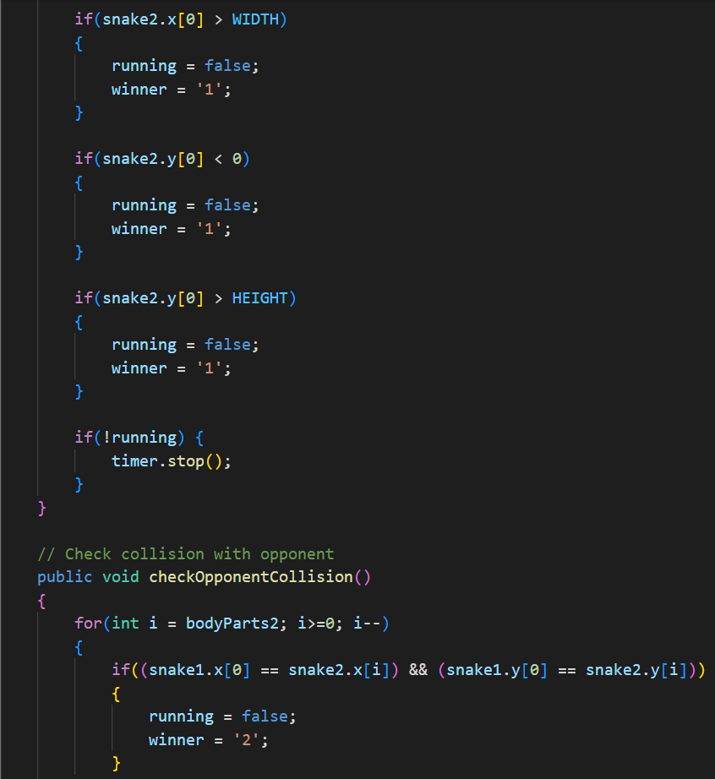

Slide 7
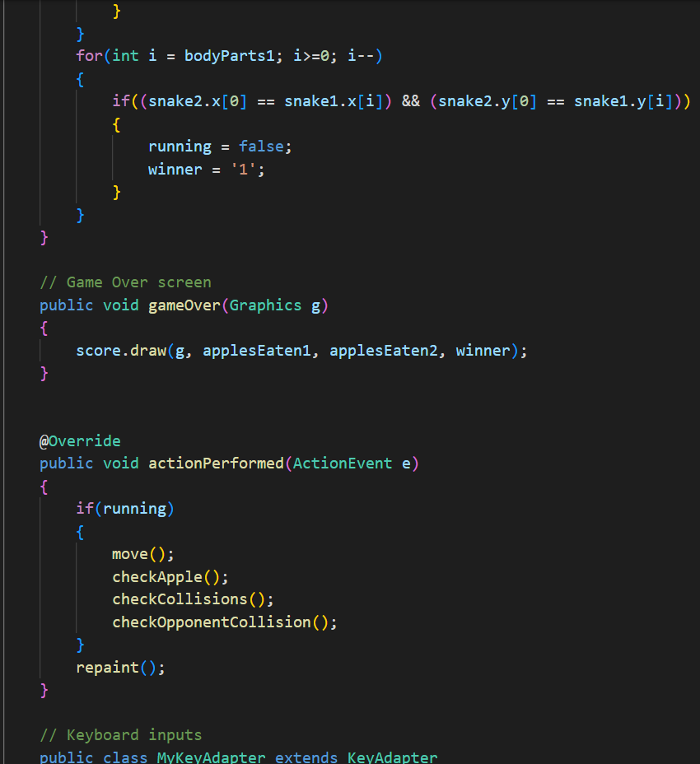
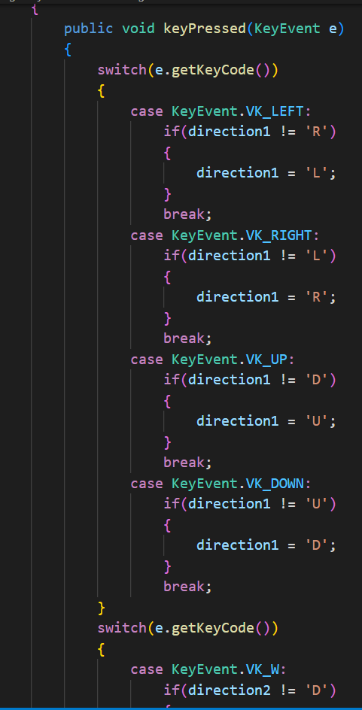
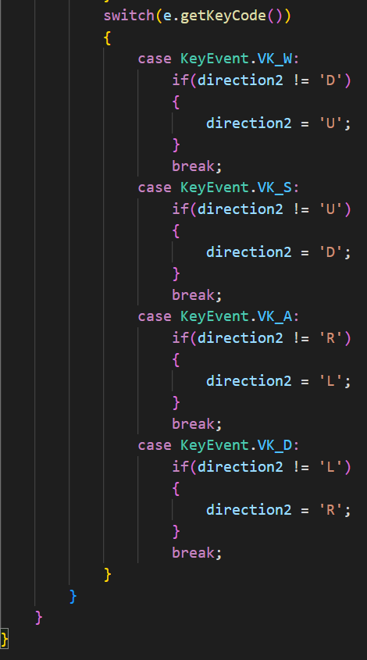

Slide 8
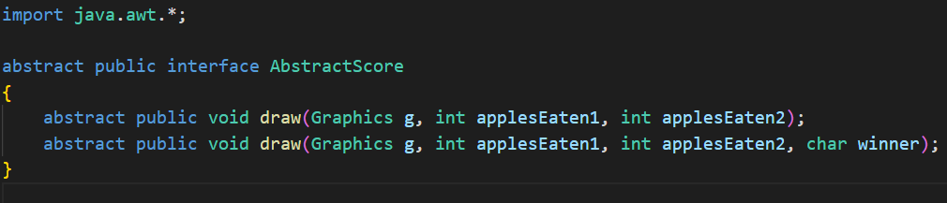
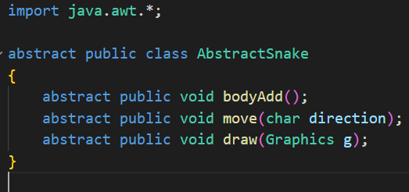
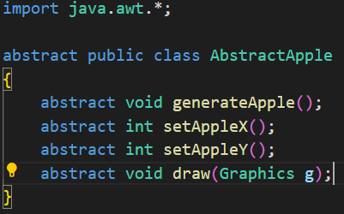
Abstract classes

Slide 9
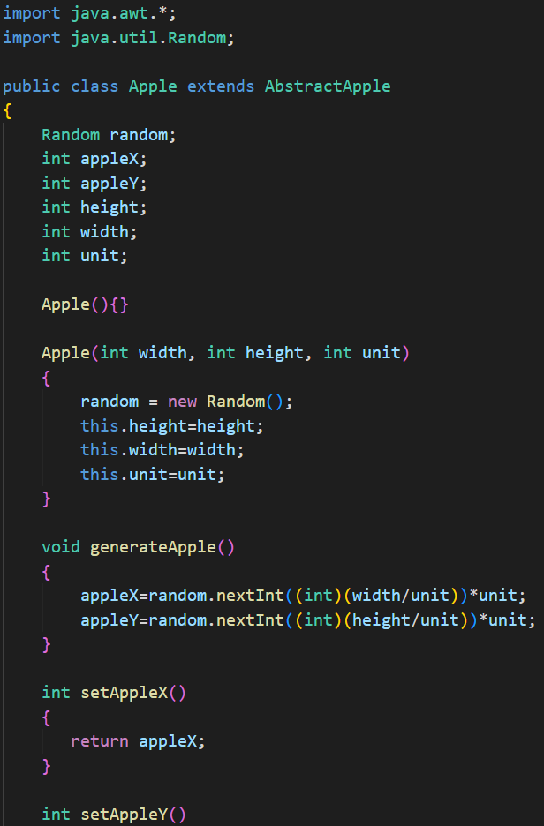
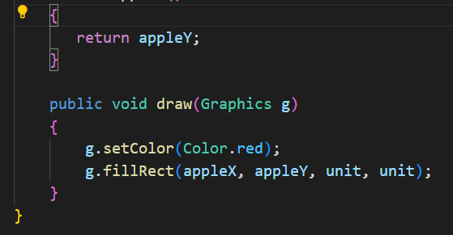
Apple

Slide 10
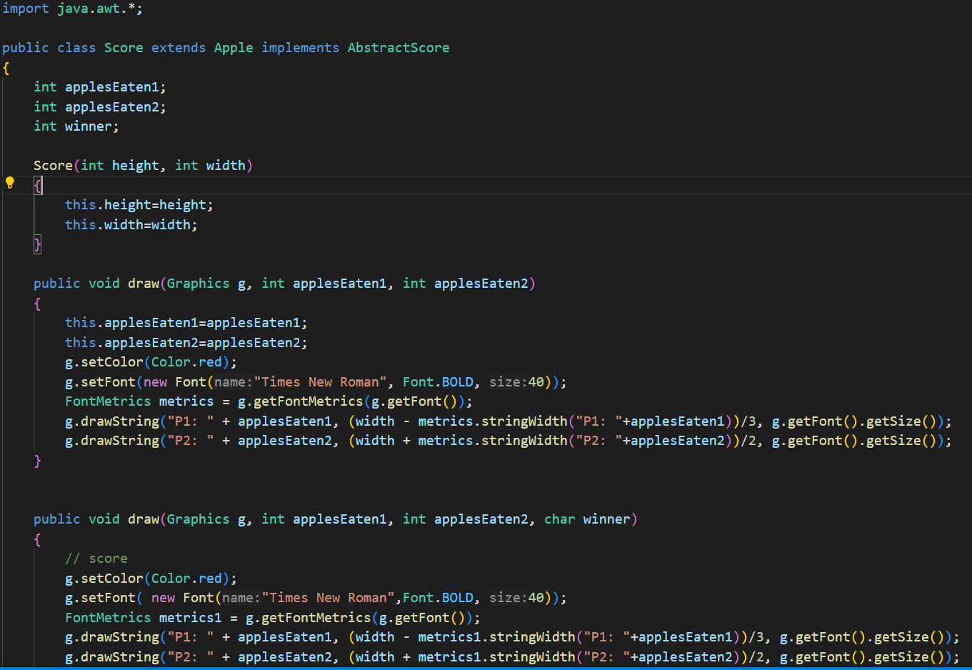
Score

Slide 11
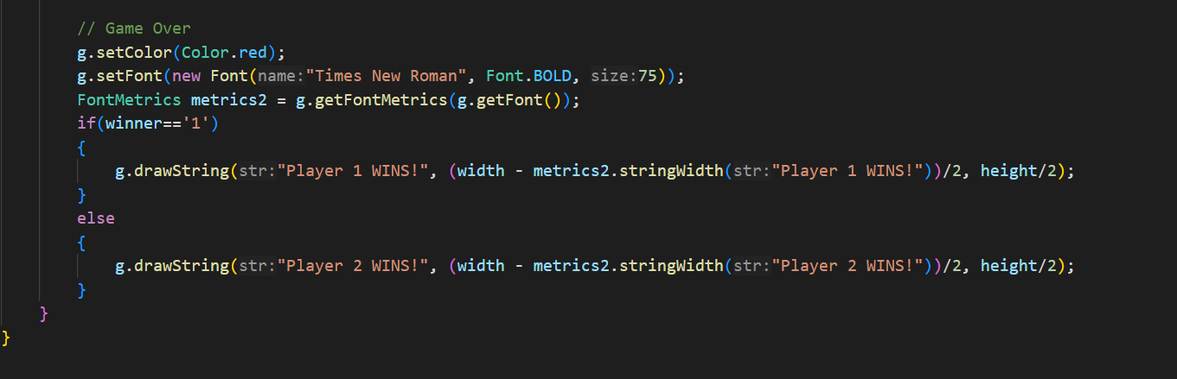

Slide 12
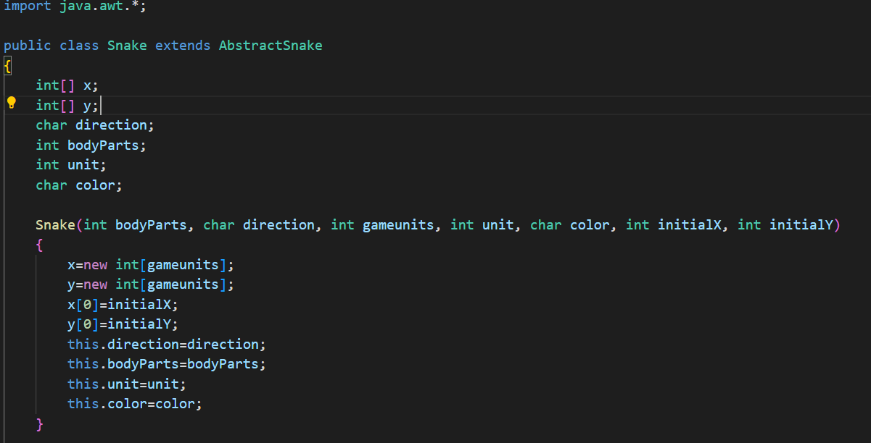
Snake

Slide 13
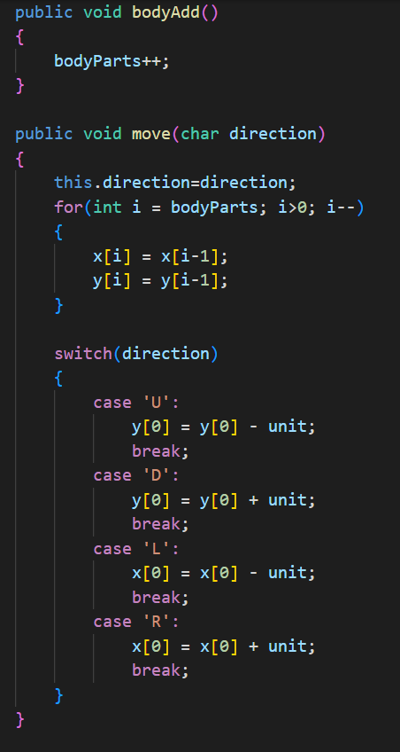
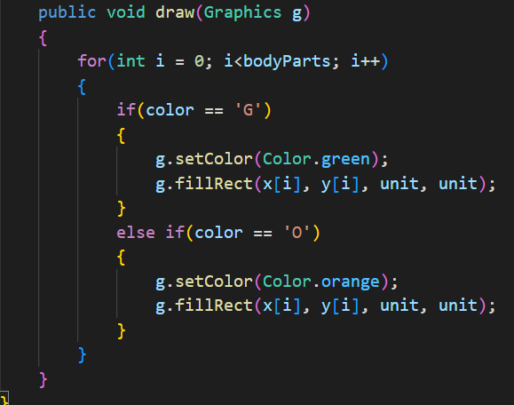

Slide 14
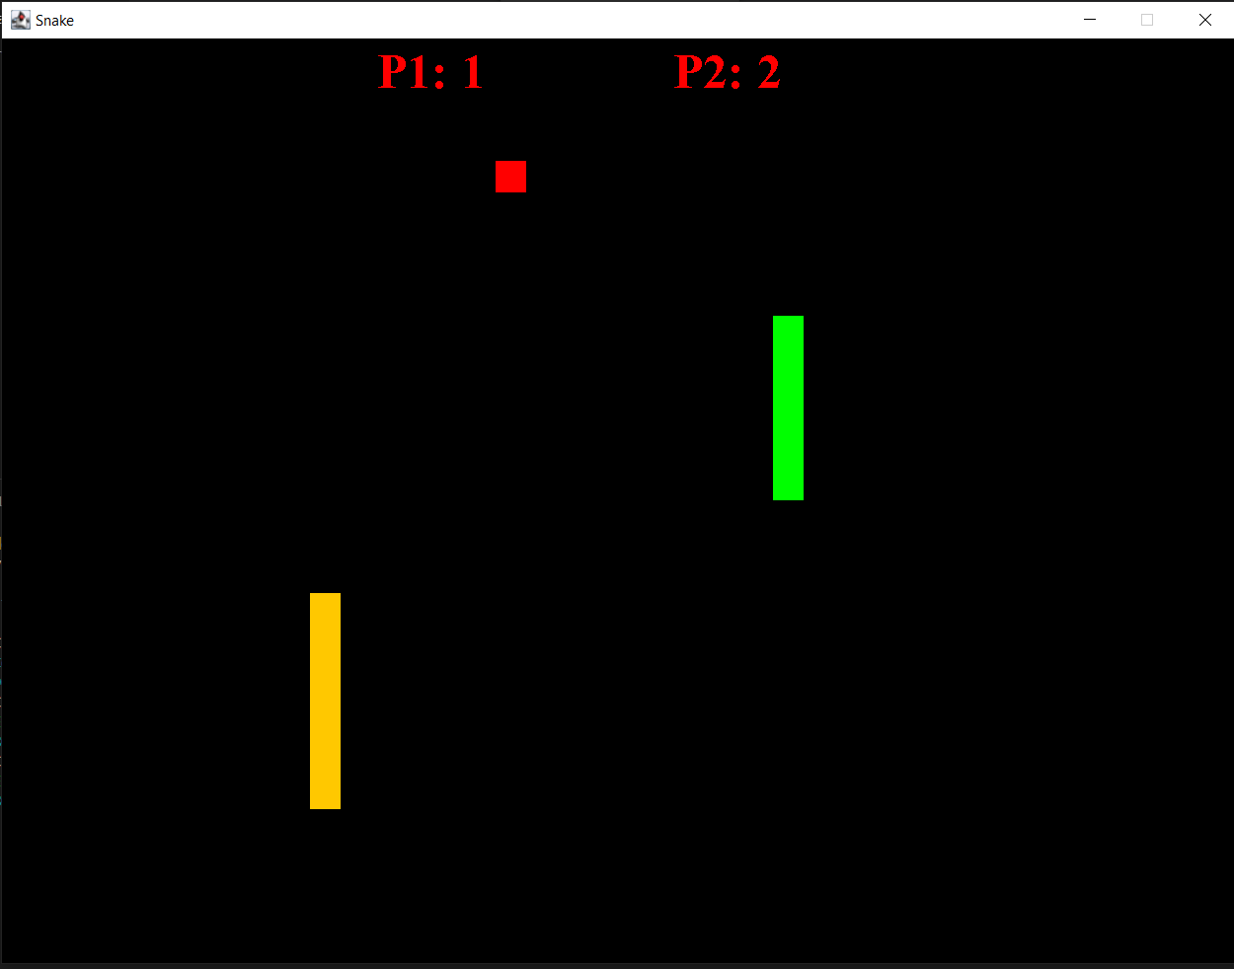
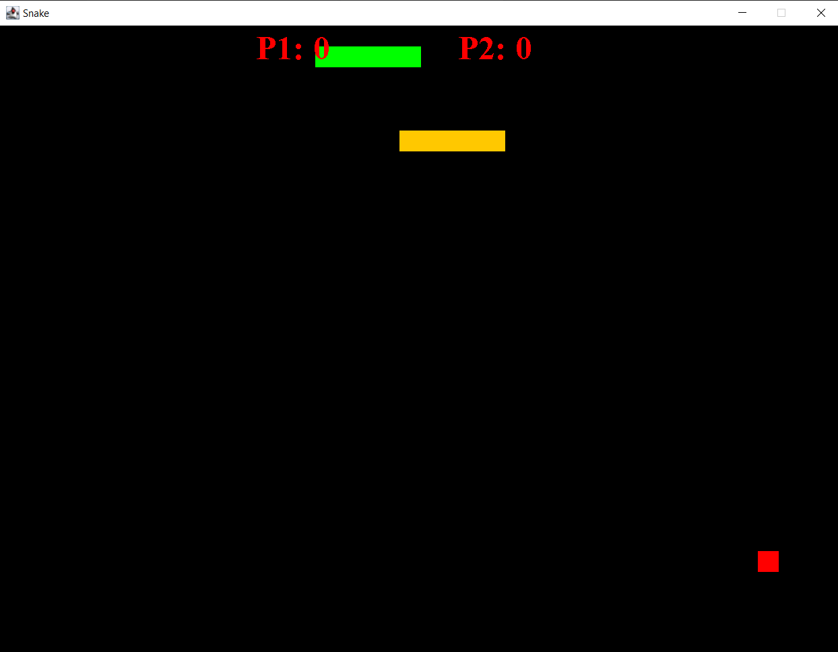
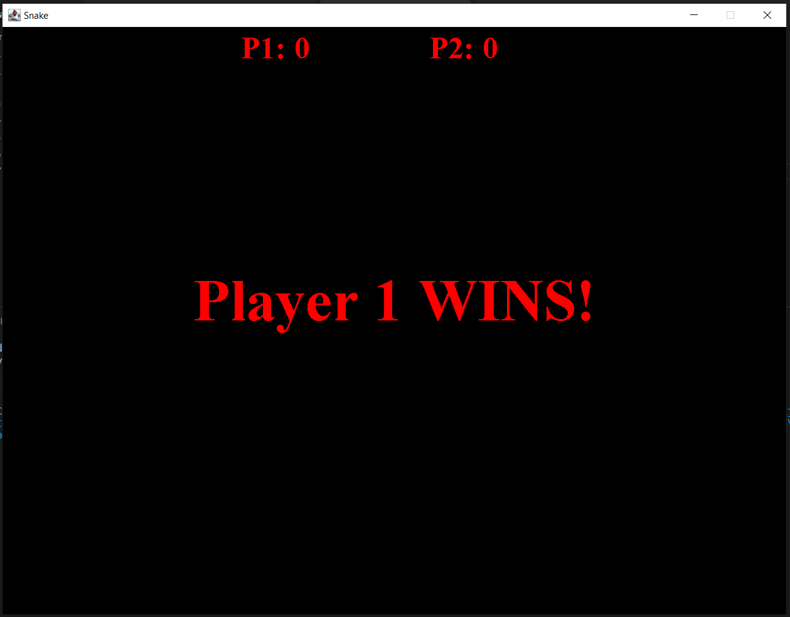
OUTPUT

Slide 15
CONCLUSION
By implementing this project, we have understood how to use concepts of object-oriented programming like encapsulation, abstraction, inheritance and polymorphism.
We also understood how to create a GUI based game using the awt library and take keyboard input using KeyAdapter.

Slide 16
THANK YOU

